Slide 1

DATA ANALYTICS FINAL PROJECT — FULL OVERVIEW
Global Climate Change
A 100-Year Analysis (1940–2040) Across 30 Countries & 4 Policy Scenarios
12,120 rows • 13 columns • 30 countries • 6 regions • 4 scenarios
Source: Kaggle — "Global Climate Change (1940–2040)" by Abdul Malik Lodhra

Slide 2
What This Covers
4 tasks, from problem definition to final insights
01
Problem Definition & Dataset Selection
Problem statement, domain, dataset quality
02
Data Cleaning & Pre-processing
Missing data, duplicates, derived features
03
EDA & Visualizations
Univariate/bivariate/multivariate + 10+ visuals
04
Insights & Conclusion
What the data shows, and what it means for the future

Slide 3

TASK 1
12,120
13
30
4
Problem Definition
& Dataset Selection
Rows
Columns
Countries
Scenarios
Dataset Source & Domain
Problem Statement
Domain: Environmental / Climate Science
Source: Kaggle — "Global Climate Change (1940–2040)" by Abdul Malik Lodhra
File: climate_dataset_extended_1940_2040.csv (raw CSV, as required)
12,120 rows × 13 columns — well above the required minimum
How do CO2 emissions, temperature, and policy differ across Historical, Current, BAU, and Green futures?
Why does the data go up to 2040?
It lets us compare different possible futures — like what happens if the world keeps polluting (BAU) versus if it switches to clean energy (Green).

Slide 4

TASK 2
Data Cleaning & Pre-processing
1
Missing values
df['Decade'] = (df['Year'] // 10) * 10
df.isnull().sum() → 0 missing across all 13 columns
df['CO2_per_capita'] = (
df['CO2_Emissions_mt'] / df['Population_Million'])
2
Duplicates
df.duplicated().sum() → checked & removed if found
df['GDP_per_capita_USD'] = (
df['GDP_Billion']/df['Population_Million']*1000)
Data types
df['Emissions_per_GDP'] = (
3
df['CO2_Emissions_mt'] / df['GDP_Billion'])
Already correct as object dtype (Country/Region/Scenario) — no conversion needed
Derived columns
# Filtering / aggregation example
4
region_avg_temp = df.groupby('Region')[
Decade, CO2_per_capita, GDP_per_capita_USD, Emissions_per_GDP
'Temp_Anomaly_C'].mean().sort_values()
Result: dataset is fully clean — 0 missing values, 0 duplicates after check

Slide 5
TASK 3
Exploratory Data Analysis
Univariate
Bivariate
Multivariate
Looking at one thing at a time — like just CO2, or just temperature — to see the normal range and any extreme values
Comparing two things together — like CO2 and temperature, or clean energy and climate policy — to see if they move together
Looking at everything together using a color-coded heatmap, to spot all the connections at once
Grouping the Data for Comparison
Instead of scrolling through 12,120 rows, this groups the data into simple comparison tables.
# Compare average temperature by Region and Scenario, side by side
pivot_temp = df.pivot_table(values='Temp_Anomaly_C', index='Region',
columns='Scenario', aggfunc='mean')
# See how key numbers changed, decade by decade
decade_summary = df.groupby('Decade').agg(
Avg_CO2=('CO2_Emissions_mt','mean'),
Avg_Temp_Anomaly=('Temp_Anomaly_C','mean'),
Avg_SeaLevel=('Sea_Level_mm','mean'))

Slide 6
VISUALIZATION 1
Temperature Anomaly Over Time by Scenario
WHAT IT SHOWS
How warming changes from 1940–2040 under 4 different futures.
Each line is one scenario: Historical, Current, BAU, Green
BAU (red) rises the fastest — the "do nothing" future
Green (green) stays flattest — the "take action" future
The gap between lines widens after 2020

Slide 7
VISUALIZATION 2
Average CO2 Emissions by Region
WHAT IT SHOWS
Which regions pollute the most, on average.
Longer bar = more average CO2 emissions
Oceania and Africa show the highest averages here
Helps identify where emission-reduction efforts matter most
Values are in million tonnes (mt)

Slide 8
VISUALIZATION 3
Share of Extreme Weather Events by Region
WHAT IT SHOWS
What percentage of all extreme weather happened in each region.
Each slice = one region's share of the total
Asia has the largest share, at 40%
Europe follows at 20%
Some regions (Oceania) see far fewer extreme events

Slide 9
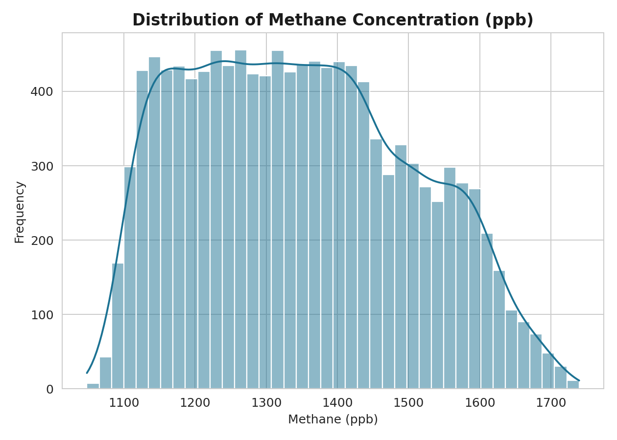
VISUALIZATION 4
Distribution of Methane Concentration
WHAT IT SHOWS
How methane readings are spread across the whole dataset.
X-axis = methane amount (ppb); Y-axis = how many records had it
Taller bar = that methane level is more common
The curved line is a smoothed version of the same shape
Most values cluster in a typical middle range

Slide 10
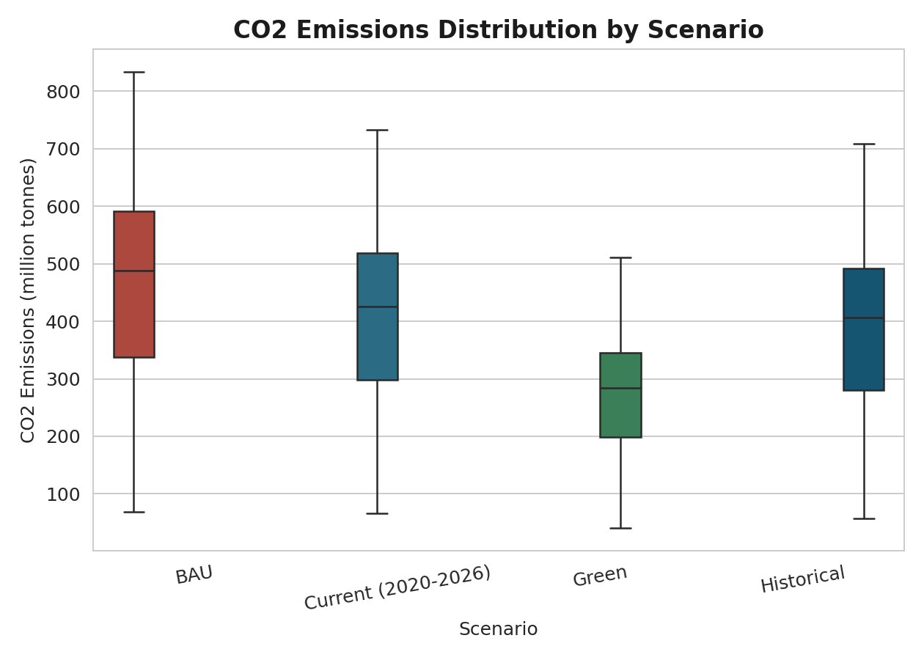
VISUALIZATION 5
CO2 Emissions Distribution by Scenario
WHAT IT SHOWS
The typical range and outliers of emissions, per scenario.
The box = the middle 50% of emission values
The line inside the box = the median
Whiskers show the normal range; dots are outliers
Lets you compare spread, not just averages

Slide 11
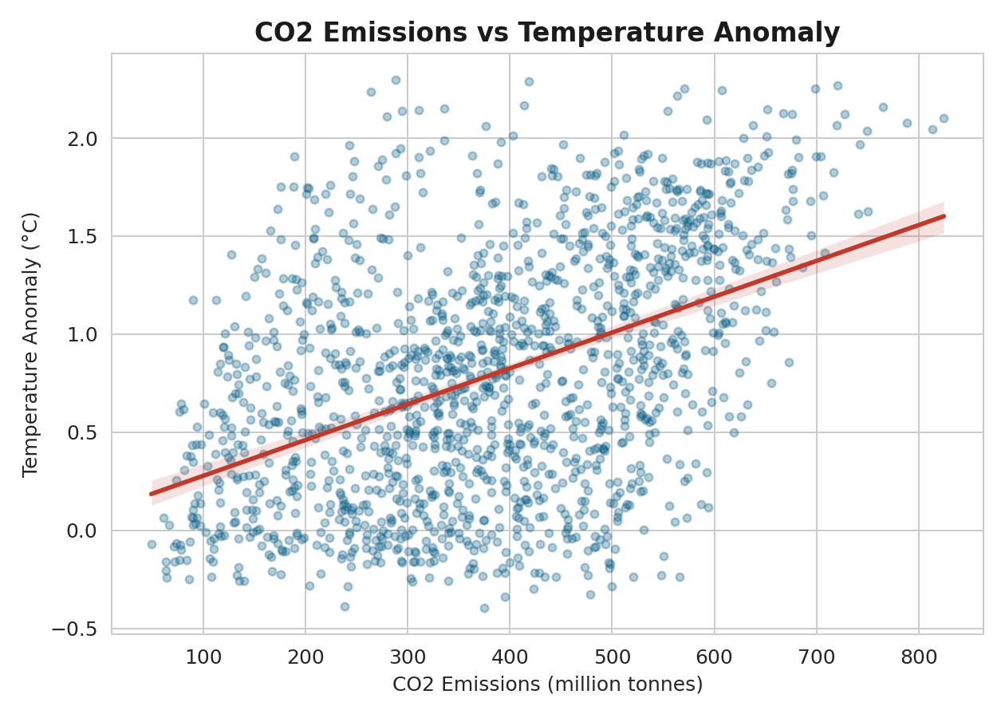
VISUALIZATION 6
CO2 Emissions vs Temperature Anomaly
WHAT IT SHOWS
Do these two variables move together?
Each dot = one record from the dataset
The red line shows the overall trend
The upward slope confirms: more CO2 tends to mean more warming
Matches the ~0.46 correlation found earlier

Slide 12
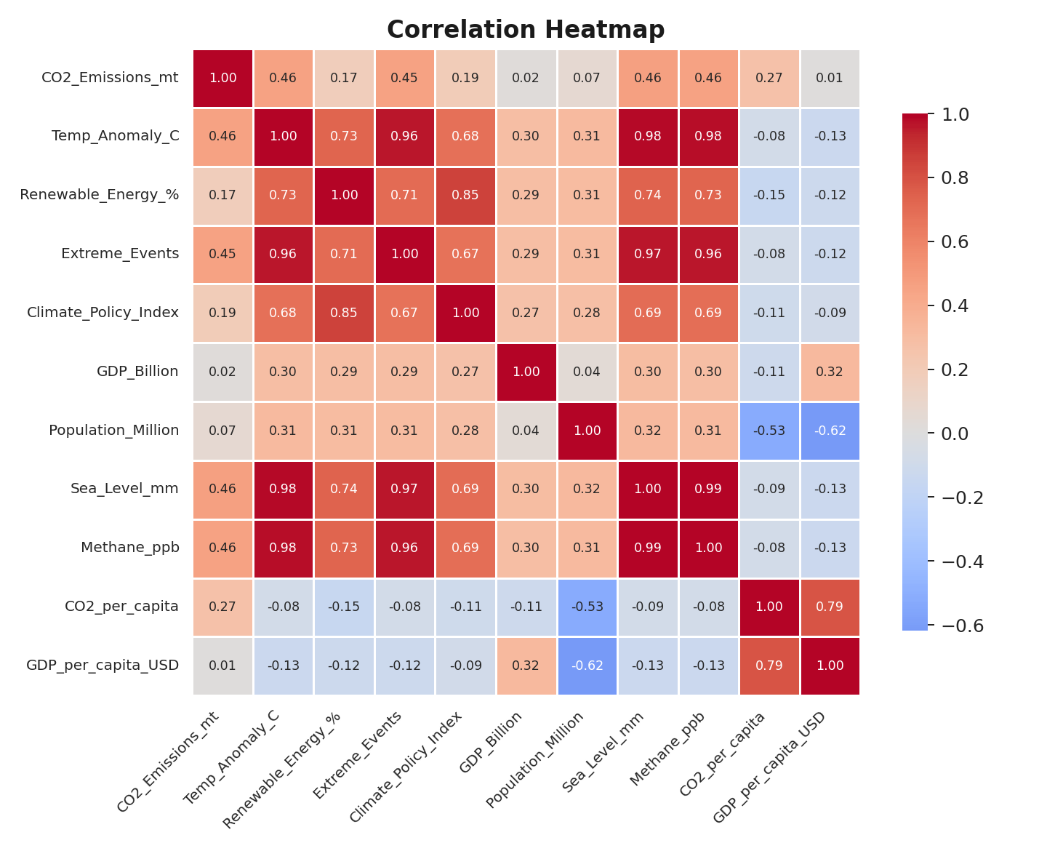
VISUALIZATION 7
Correlation Heatmap
WHAT IT SHOWS
How every variable relates to every other variable, at a glance.
Dark red = strong positive relationship
Dark blue = strong negative relationship
Pale color = little to no relationship
Temp ↔ Sea Level is nearly 0.98 — almost a perfect match

Slide 13
VISUALIZATION 8
Historical vs Green — Side by Side
WHAT IT SHOWS
A direct "before vs after" comparison — what really happened, versus what could happen with strong climate action.
Left: Green scenario shows lower CO2 emissions than Historical
Right: Green scenario shows higher renewable energy adoption
Same time period, same starting point — only the policy path differs
Shows the real gap between reality and an ambitious clean-energy push

Slide 14
VISUALIZATION 9
Sea Level Rise by Decade
WHAT IT SHOWS
How much sea level has risen, decade by decade.
Each bar = one decade's average sea level (mm)
Bars get taller over time — rise is accelerating
Speeds up noticeably after the 2000s
Matches the near-perfect link with temperature (~0.98)

Slide 15
VISUALIZATION 10
Renewable Energy Adoption by Region
WHAT IT SHOWS
How clean energy use has grown differently across regions.
Interactive in the notebook (Plotly) — hover to see exact values
Each line = one region's renewable energy % over time
Some regions adopt clean energy faster than others
Useful for spotting regional leaders and laggards

Slide 16
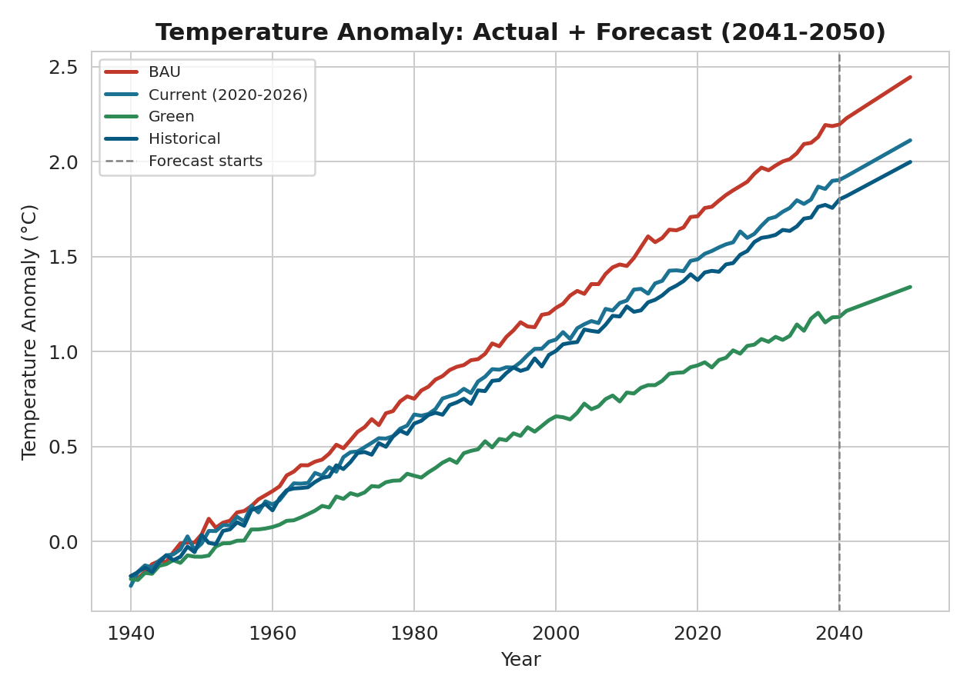
VISUALIZATION BONUS
Future Forecast — Beyond 2040
WHAT IT SHOWS
Extending the trend 10 more years, to 2050.
Solid lines (to 2040) = real data; dashed line marks where forecasting begins
Uses simple Linear Regression to extend each scenario's trend
BAU keeps climbing steepest; Green rises much more slowly
A trend estimate, not a guaranteed outcome

Slide 17
KEY INSIGHTS
What the Data Tells Us
1
After 2020, the paths split apart.
Green stays cooler, BAU keeps heating up.
2
More CO2 = more warming.
The data confirms it — they rise together.
3
Stronger policy = more clean energy.
Countries with tougher climate rules use more renewables.
4
Asia and North America pollute the most.
Makes sense — they have the biggest economies and populations.
5
Sea levels are rising faster over time.
It sped up a lot after the 2000s.
6
Extreme weather isn't spread out evenly.
Some regions get hit a lot more than others.

Slide 18
Conclusion
WHAT WE FOUND
WHAT HAPPENS NEXT
CO2, temperature, and sea levels have all been rising since 1940
If we keep polluting like now,
warming keeps getting worse all the way to 2040 and beyond.
After 2020, the future looks very different depending on what the world does
If we switch to clean energy and stronger policies,
If nothing changes (BAU) → things keep getting worse
warming slows down a lot.
If the world goes green → things stay much more stable
What we do today decides which future we get.

Slide 19
Thank You
Global Climate Change (1940–2040) | Data Analytics Final Project

